Slide 1
Collaborative & Content Based Restaurant Recommendation System for OpenRice
Huang Jiawen / Tang Shihui / Chen Qilin / Wang Guoquan
2
0
1
8

Slide 2
01
Introduction of OpenRice
CONTENTS
02
Data Crawler
03
Preprocessing
04
Recommender Algorithm
05
Analysis of Result

Slide 3
Introduction of OpenRice
/01

Slide 4

Introduction of OpenRice
OpenRice is the most popular dietary information media in Hong Kong, providing the latest and most comprehensive restaurant information, food reviews and ratings.

Slide 5
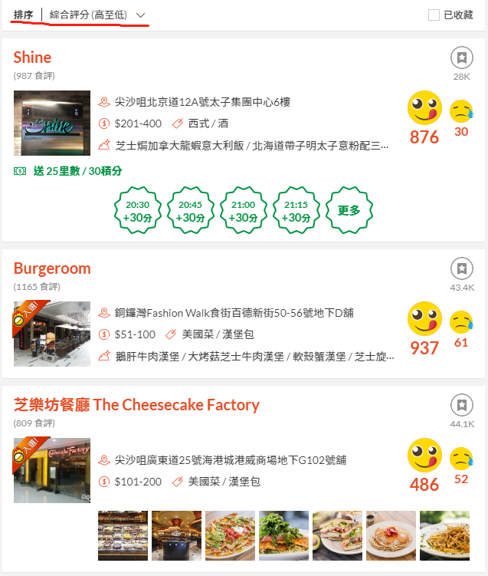
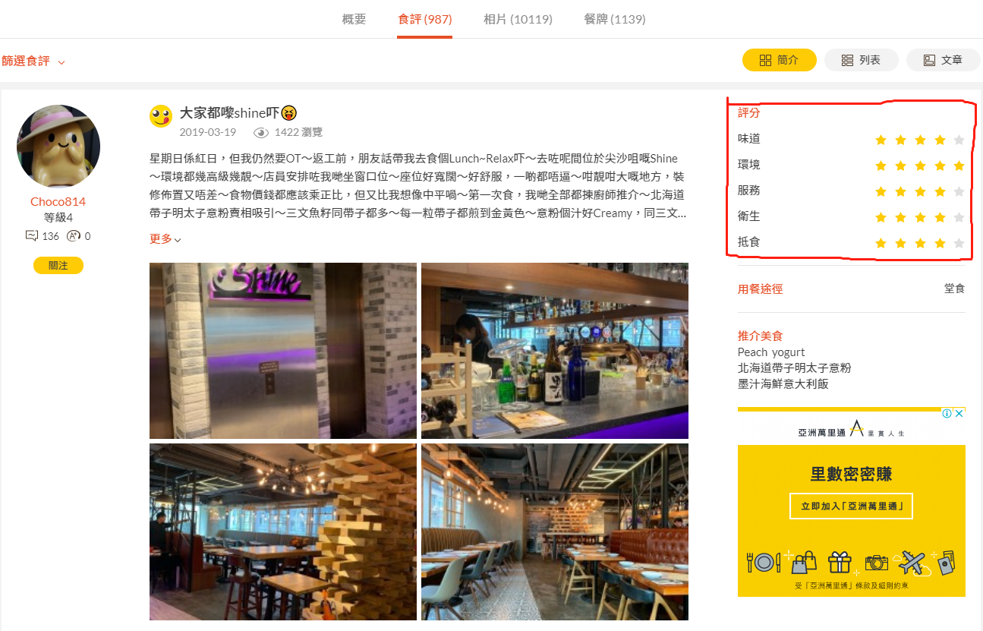
Introduction of OpenRice
We selected the top 100 restaurants in Hong Kong with the highest score in openrice.
Then, collect user rating data for each restaurant.

Slide 6
Data Crawler
/02

Slide 7
Data Crawler
In order to crawl the data, we must first figure out the url or api of the webpage, and find out their rules.

Slide 8
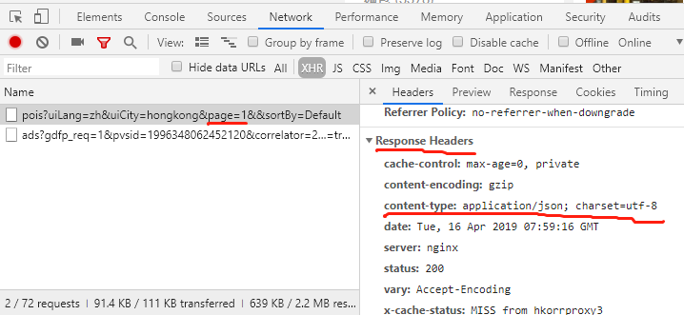
Data Crawler (Restaurants Info)
https://www.openrice.com/api/pois?uiLang=zh&uiCity=hongkong&page=(1~7)&&sortBy=Default
For the restaurants information, the restaurants information was obtained through an ajax request. The restaurant is well sorted (15 restaurants per page) by its rating score. So, we can request the api from 1 to 7 pages to get the user rating url of each restaurant of top 100.

Slide 9
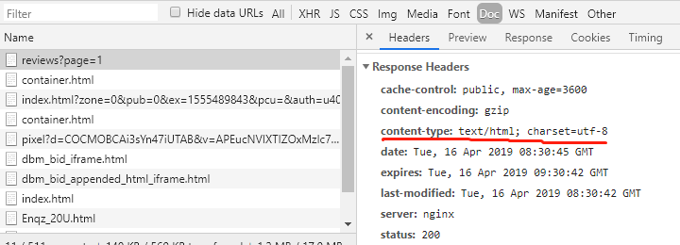
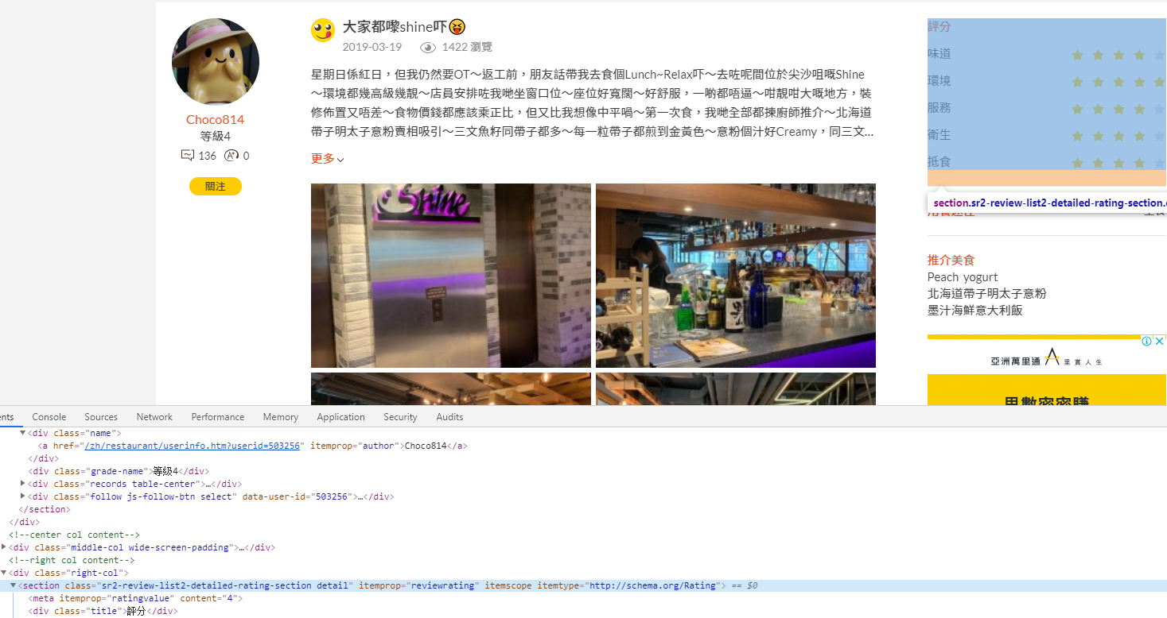
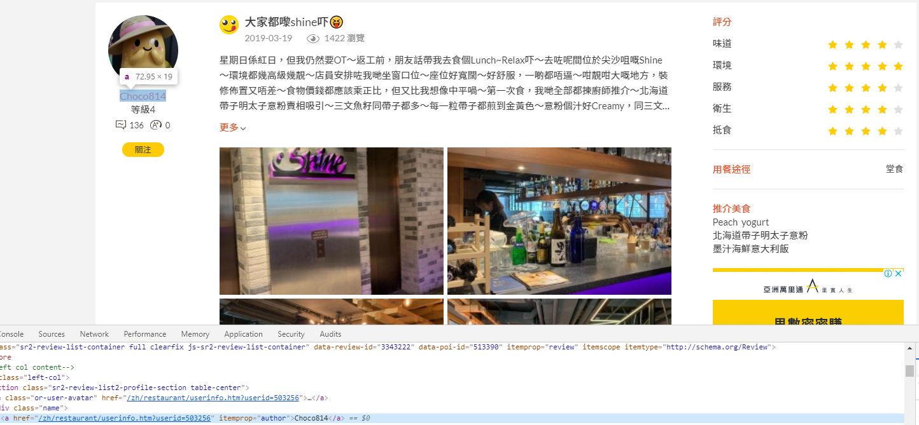
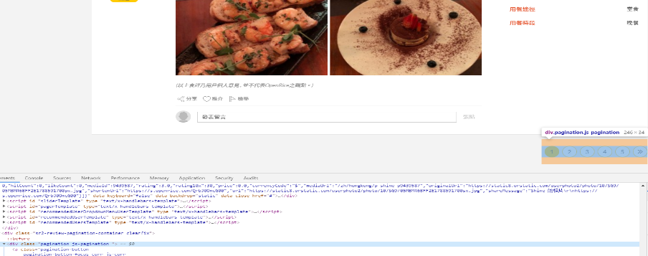
Data Crawler (User and his rating of a restaurant)
https://www.openrice.com/zh/hongkong/(restaurant_name)/reviews?page=(1~∞)
For the user’s rating, we request the restaurant url that we have been obtained. It will response a html page, and we use the Beautiful Soup to extract the usernames and its ratings. In one restaurant, we recursively access all user ratings pages (15 ratings per page) to get all user rating.

Slide 10
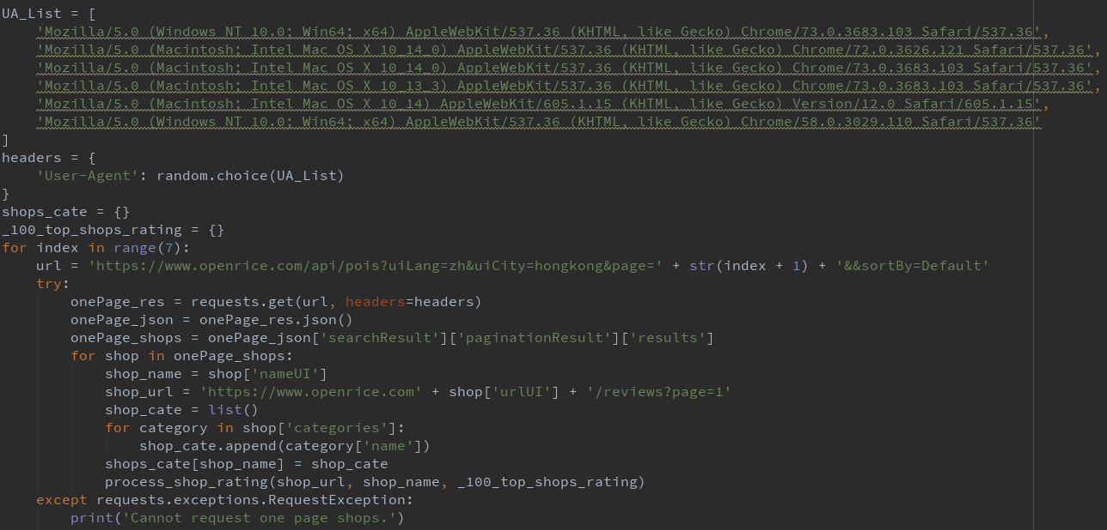
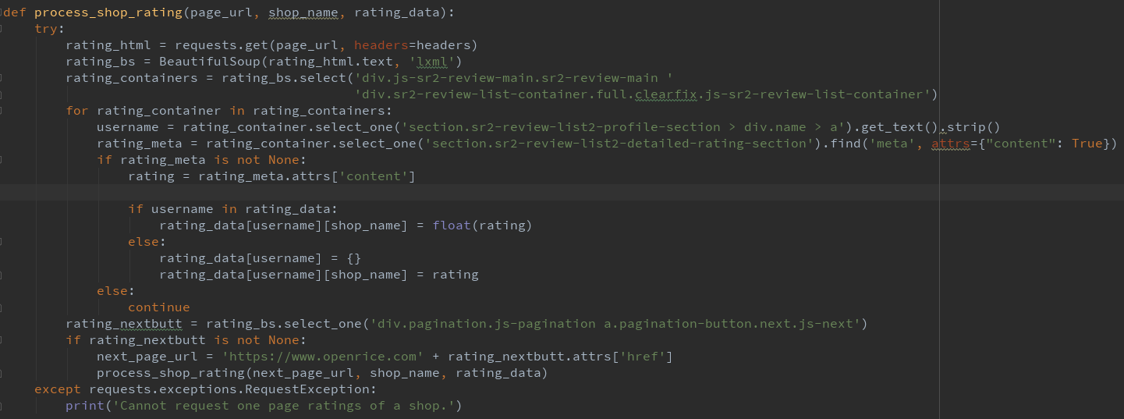
Data Crawler (Code)

Slide 11
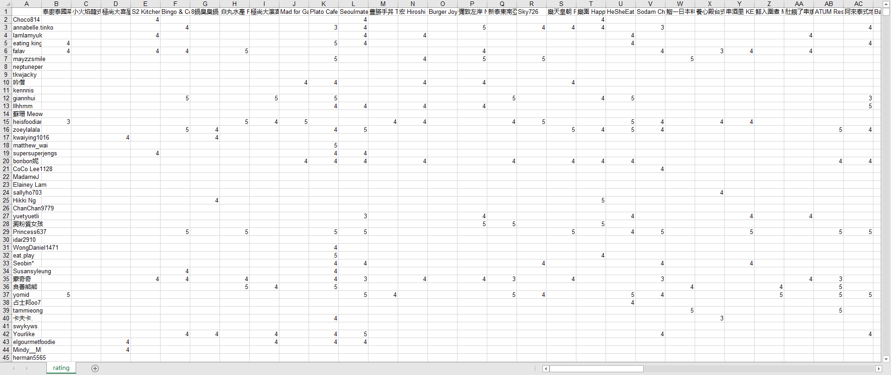
Data Crawler (Export the crawled data to excel)
Using the xlwt to export rating data to the excel.

Slide 12
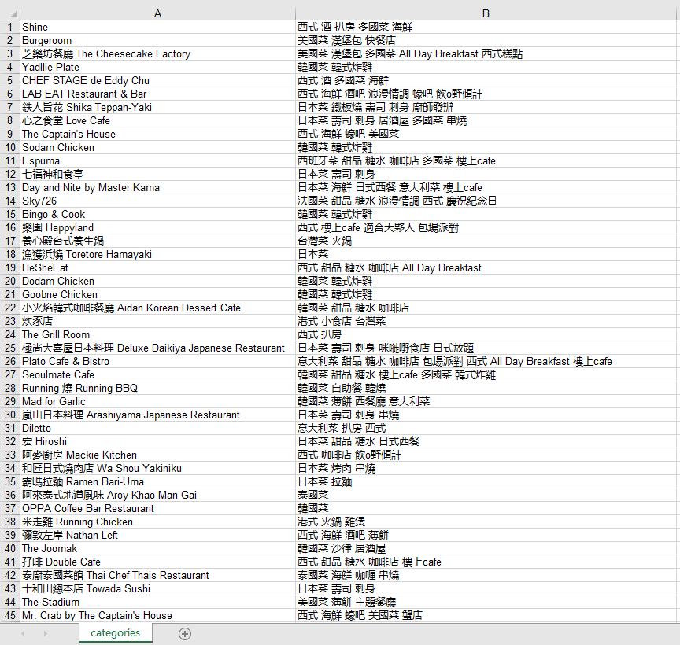
Data Crawler (Export the crawled data to excel)
Restaurants’ Tags: For Content-Based

Slide 13
Preprocessing
/03

Slide 14

Preprocessing
Using the xlrd to import the rating data to the excel. Then, processing the data into a dictionary structure.
Example:

Slide 15
Recommender Algorithm
/04

Slide 16
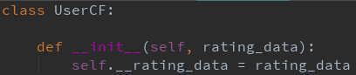
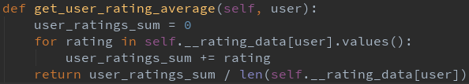
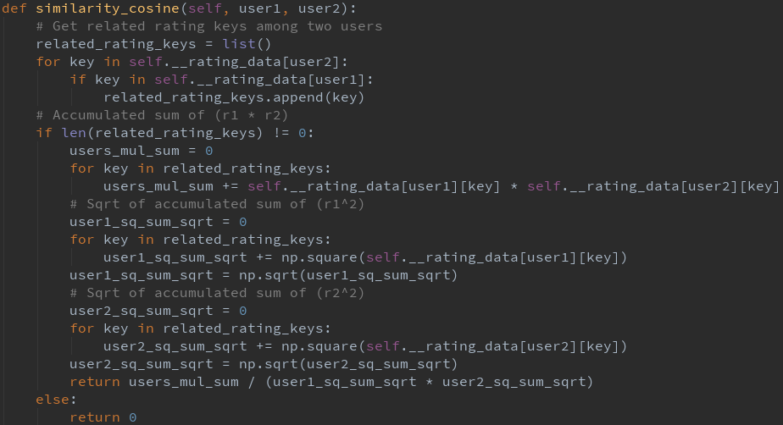
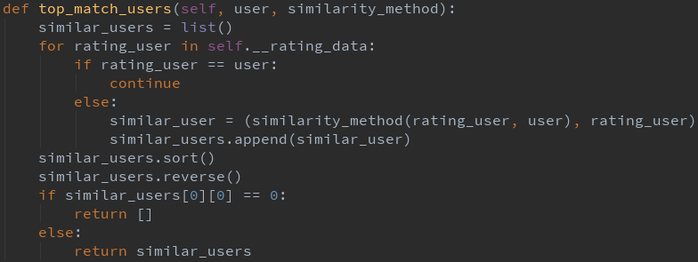
Recommender Algorithm (User-Based Collaborative Filtering)
Initialization: Initialize the rating data
Calculate the cosine similarity: pass two usernames, return the cosine similarity between two users (return 0 if there are no related rating).
Calculate the average: pass the username, return the user average rating
Get similar users list: pass the username and the similarity method (cosine similarity, pearson correlation coefficient), return sorted similar users list (return [] if first element’s similarity score is 0)

Slide 17
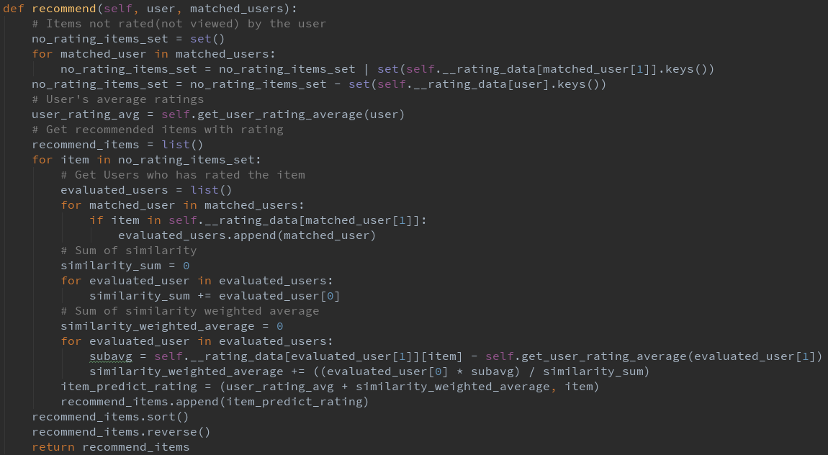
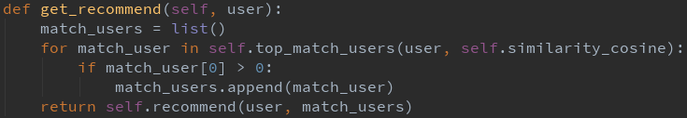
Recommender Algorithm (User-Based Collaborative Filtering)
Do recommend: pass the username and similar users, return the recommended restaurant list
Call interface: pass the username, return the recommended restaurant list

Slide 18
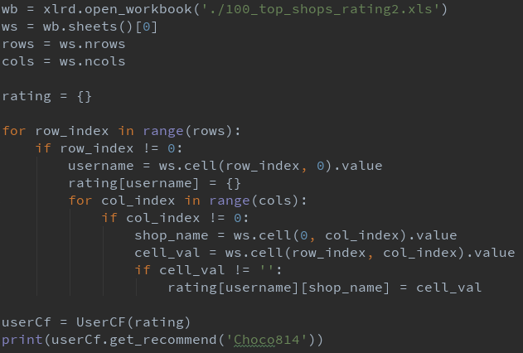
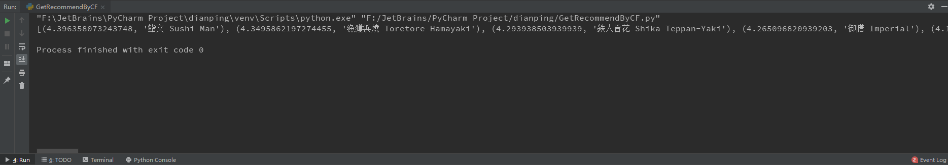
Recommender Algorithm (User-Based Collaborative Filtering)
Result: [(4.396358073243748, '鮨文 Sushi Man'), (4.3495862197274455, '漁獲浜燒 Toretore Hamayaki'), (4.293938503939939, '鉄人旨花 Shika Teppan-Yaki'), (4.265096820939203, '御膳 Imperial'), (4.164362969122057, "Mr. Crab by The Captain's House"), (4.142812636736061, 'Burger Joys'), (4.121916256503808, '鮨一日本料理 G One Sushi Japanese Restaurant'), (4.114905846433186, '焱丸水產 Flame Japanese Cuisine'), (4.111261672146326, 'CHEF STAGE de Eddy Chu'), (4.077369572329373, '養心殿台式養生鍋'), (4.075469294422535, '豊勝手丼 Toyo Katte Don'), (4.063699712700835, 'The Right Place'), ……,(3.7582811054665686, '神戶屋日韓放題 Kobe Fusion Restaurant'), (3.730465531247977, '泰廚泰國菜館 Thai Chef Thais Restaurant'), (3.7215220956362787, 'PAN de PAIN Pancakes & Sweets'), (3.718330092059439, "I's Land Cafe"), (3.7173797987746724, '第三站 Station 3 Cafe')]

Slide 19
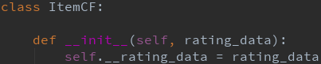
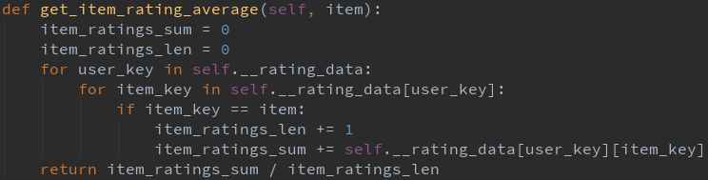
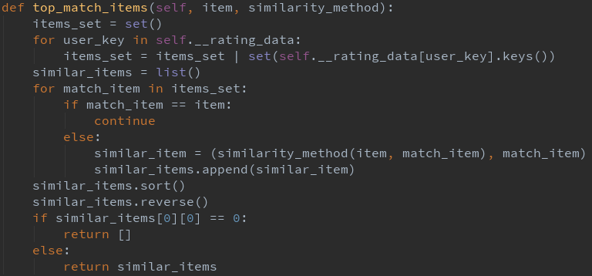
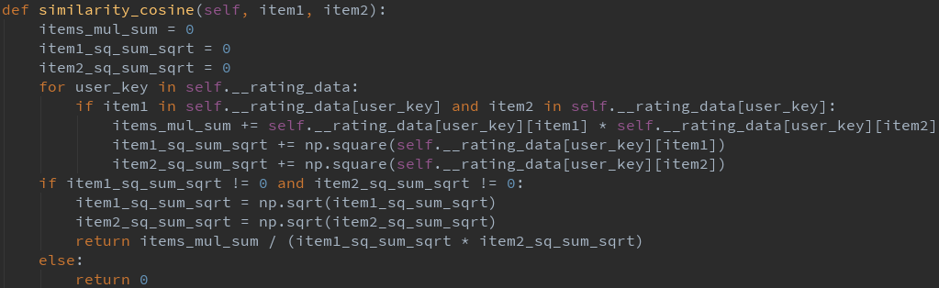
Recommender Algorithm (Item-Based Collaborative Filtering)
Initialization: Initialize the rating data
Get similar items list: pass the restaurant name and the similarity method (cosine similarity, pearson correlation coefficient), return sorted similar restaurants list (return [] if first element’s similarity score is 0)
Calculate the average: pass the restaurant name, return the restaurant average rating
Calculate the cosine similarity: pass two restaurant names, return the cosine similarity between two restaurants (return 0 if there are no related rating).

Slide 20
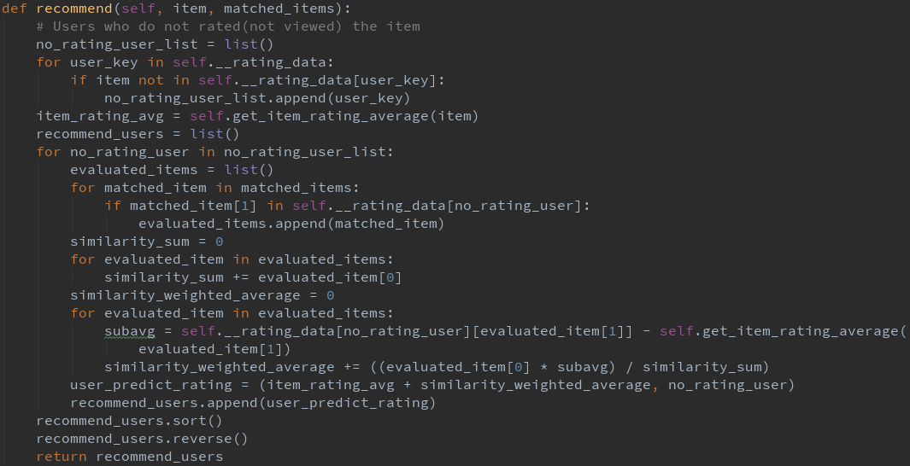
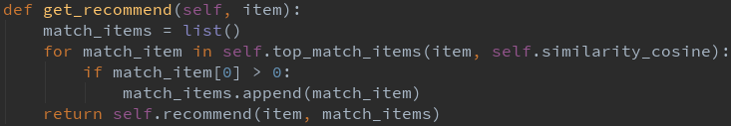
Recommender Algorithm (Item-Based Collaborative Filtering)
Do recommend: pass the restaurant name and similar restaurants, return the recommended user list
Call interface: pass the restaurant name, return the recommended user list

Slide 21
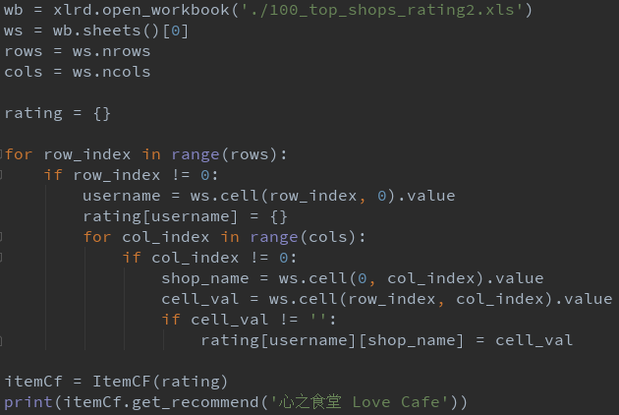
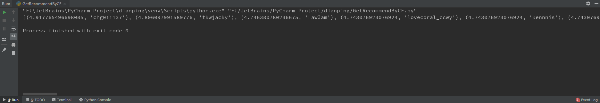
Recommender Algorithm (Item-Based Collaborative Filtering)
Result: [(4.917765496698085, 'chg011137'), (4.806097991589776, 'tkwjacky'), (4.746380780236675, 'LawJam'), (4.743076923076924, 'lovecoral_ccwy'), (4.743076923076924, 'kennnis'), (4.743076923076924, 'hauhau0323'), (4.684470542197094, 'swykyws'), (4.683246135606154, 'tammieong'), (4.6828511726238435, 'CoCo Lee1128'), (4.5988201235460275, 'GabriellePoon'), (4.5980986309918235, 'mayzzsmile'), (4.552216098588726, 'giannhui'), (4.48361954682842, 'foodcritics1011'), (4.438578299025543, 'eat.play'), (4.405084910202161, 'ttfoodfood'), (4.3908408431844945, 'alvahana'), (4.359685192919907, 'violetloveeating'), (4.346457155764806, 'AprilYui'), (4.31755702216588, 'Princess637’), ……, (2.743076923076923, 'ChanChan9779'), (2.719327803084342, 'kazumi.wong'), (1.7430769230769232, 'herman5565'), (0.7430769230769232, 'sleepsean'), (0.7430769230769232, 'Elainey Lam')]

Slide 22
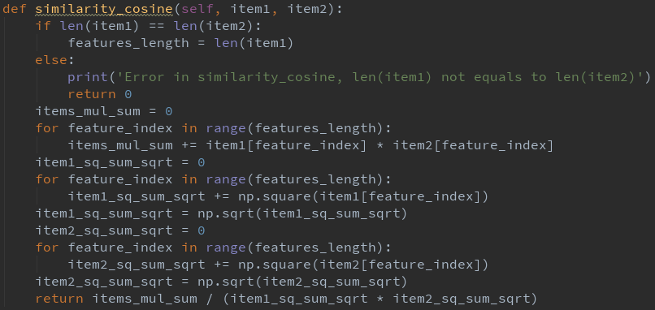
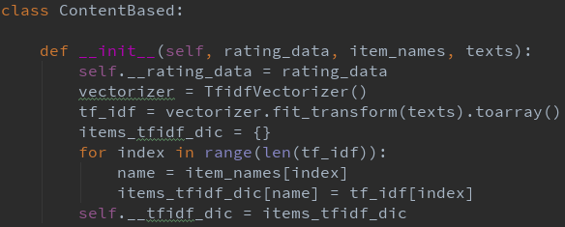
Recommender Algorithm (Content-Based Recommendation)
Initialization: pass the rating data, item names and content texts, initialize the rating data and tf-idf matrix
Calculate the cosine similarity: pass two restaurant names, return the cosine similarity between two restaurants (return 0 if there are no related rating).

Slide 23
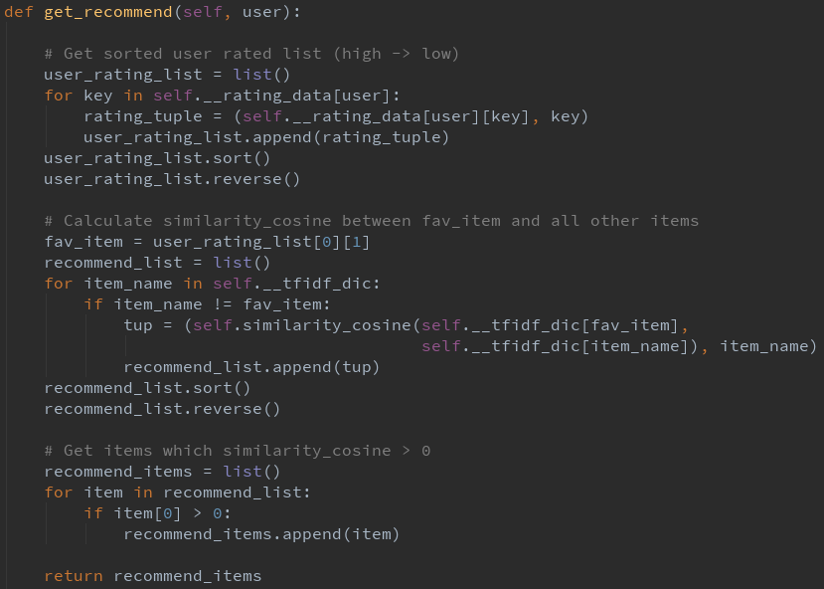
Recommender Algorithm (Content-Based Recommendation)
Call interface: pass the username, return the recommended item list

Slide 24
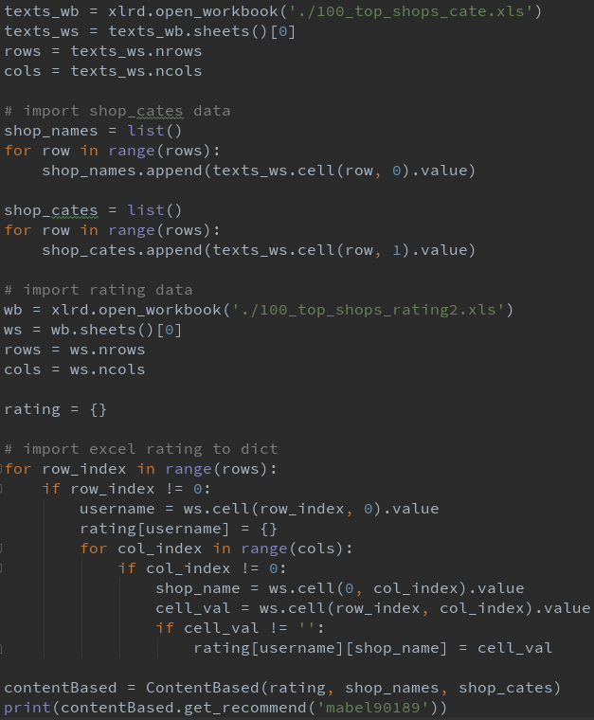
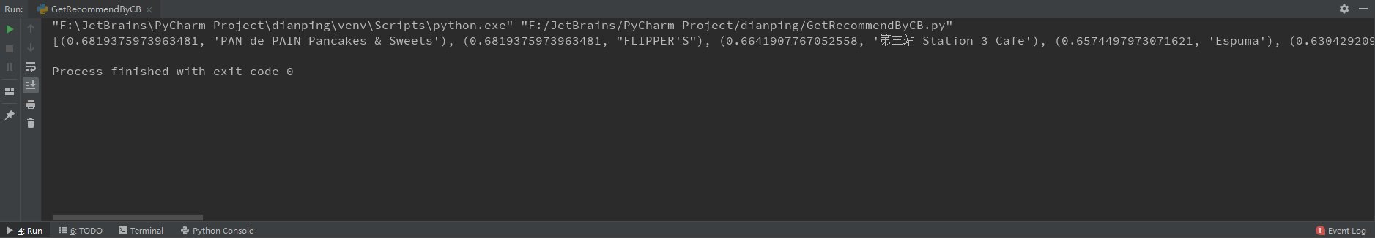
Recommender Algorithm (Content-Based Recommendation)
Result: [(0.6819375973963481, 'PAN de PAIN Pancakes & Sweets'), (0.6819375973963481, "FLIPPER'S"), (0.6641907767052558, '第三站 Station 3 Cafe'), (0.6574497973071621, 'Espuma'), (0.6304292095275998, '小火焰韓式咖啡餐廳 Aidan Korean Dessert Cafe'), (0.6055073600951524, 'Plato Cafe & Bistro'), (0.5601407596403647, "I's Land Cafe"), (0.5437879337174838, 'HeSheEat'), (0.5186652706702127, 'Seoulmate Cafe'), (0.4671019584492802, '街坊Cafe Kaifong Cafe'), (0.4652307411620679, '慢煮工業 The Hangout by Under Vacuum'), (0.4508335201549288, "一起果醬 Let's Jam"), (0.44174496259041085, 'ATUM Restaurant'), (0.4172790144015754, '2DP’), ……, (0.1653578567363892, 'Diletto'), (0.15431828895891794, 'Babbo Trattoria'), (0.14730785782979222, 'Shine'), (0.14203131294772264, '彌敦左岸 Nathan Left'), (0.133870356958328, "The Captain's House"), (0.11871056137416938, 'Little Vegas'), (0.10804807919812513, "Mr. Crab by The Captain's House"), (0.09962227222892597, 'LAB EAT Restaurant & Bar')]

Slide 25
Analysis of Result
/05

Slide 26
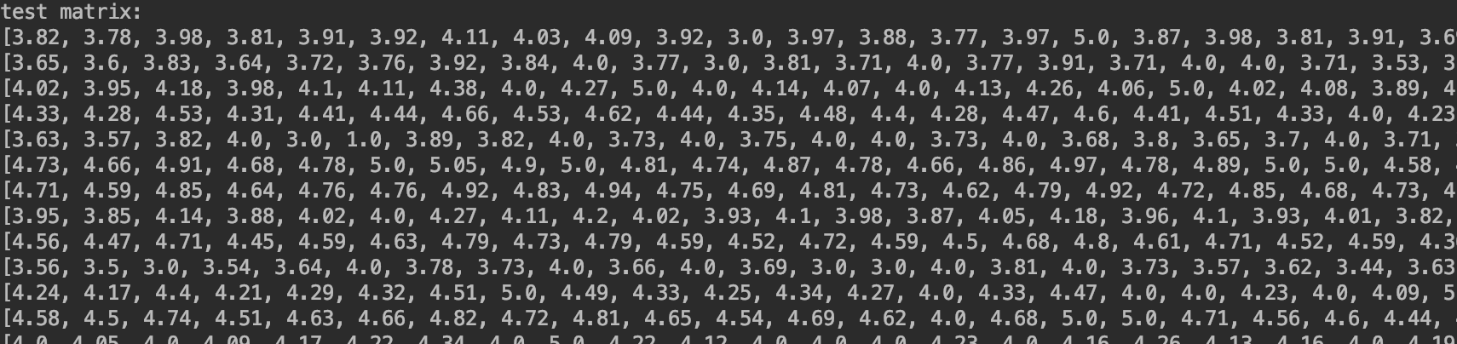
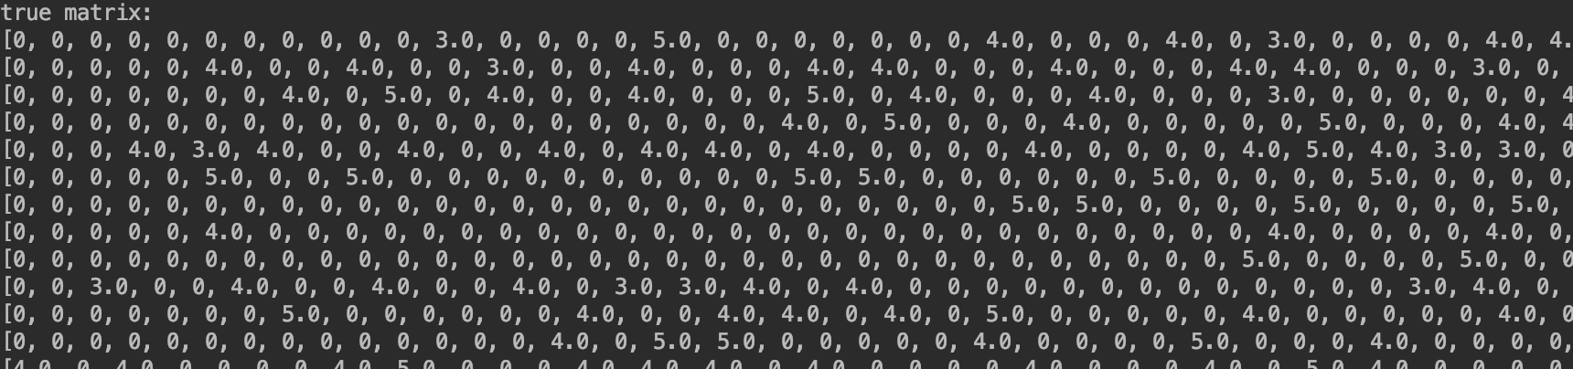
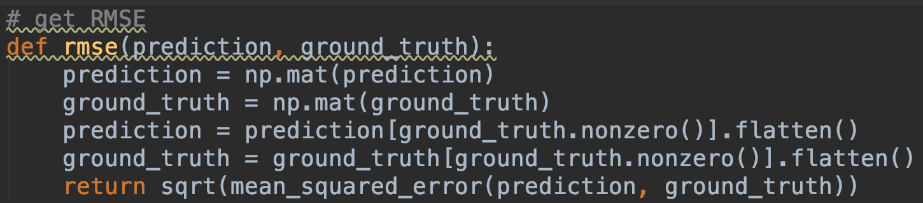
Step
Randomly select 2% users as test users
Extract original score and predicted
score and Convert to matrix
Compute the RMSE value between
original score and predicted score

Slide 27
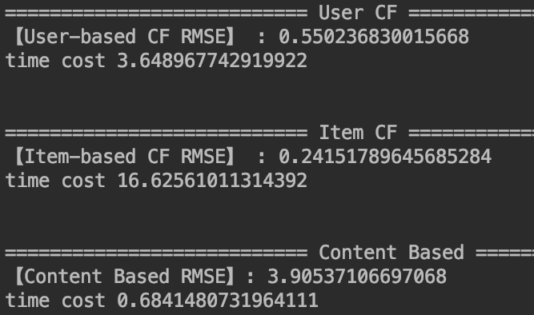
Result

Slide 28
Analysis
Accuracy：
Due to Limited Content Analysis, it is difficult to extract the characteristics of the restaurant,
resulting in low accuracy.Content based recommendation is more suitable for the item based on text （such as News)
Efficiency:
When the training set is large, item based collaborative filtering is less efficient

